Slide 1
Romanticism to Realism

Slide 2
Good Morning! 1/11/2016
Turn-in:
Take out: Romanticism homework, journal, writing utensil
Fast Five: Work on page 878!
Homework: Poetry characteristic identification, individual book assignment (1/19/16)

Slide 3
Individual Book Assignment Reminder
Packet
Review to turnitin.com 1st, then Skyline Library Website (Instructions about content and submission on the packet handed out in November)
Both due 1/19/16

Slide 4
Romanticism – review of characteristics
Unrealistic Characters
Character is a “god”
Plot is unusual events, mystery, high adventure
Story is “told”
Exaggeration (hyperbole)
Setting is for plot
The language is often “literary” (formal)

Slide 5
Poetry Puzzle
In groups of 4 – discuss the poems you selected for homework and elements of Romanticism you identified. Similarities and differences?
Come select one of the poems
1. Read out loud once
2. Discuss what you “notice” – can be as simple as I notice these words, or 10 lines, or rhyme at the end
3. Read out loud again, paying attention to phrases which support the characteristics of romanticism
4. Underline and mark characteristics
5. cut out the characteristics and tape to the papers on the wall (once you have identified as many as you can)

Slide 6
Homework
Write down the title of the other poem
Bring an annotated copy to class tomorrow (stamp)

Slide 7
Good Morning! 1/11/2016
Turn-in: Romanticism worksheet
Take out: Romanticism homework, writing utensil, journal, (scissors if you have them)
Fast Five: In general, what are the characteristic's of Romanticism? Pick two and write a “line of poetry” (sentence) as an example.
Homework: Poetry characteritic identification

Slide 8
Romanticism vs. Realism
Romanticism
Realism
Unrealistic Characters
Character is a “god”
Plot is unusual events, mystery, high adventure
Story is “told”
Exaggeration
Setting is for plot
The language is often “literary” (formal)
Realistic characters
Characters are normal people
Plot is ordinary events
Story is “shown”
Objectivity
Setting is for characterization
Writer uses everyday, “normal speech

Slide 9
Realism – focus on the ordinary
Focus on everyday activities instead of romanticized, stylized interpretations
Characters resemble ordinary people
Writer is interested in recent or contemporary life

Slide 10
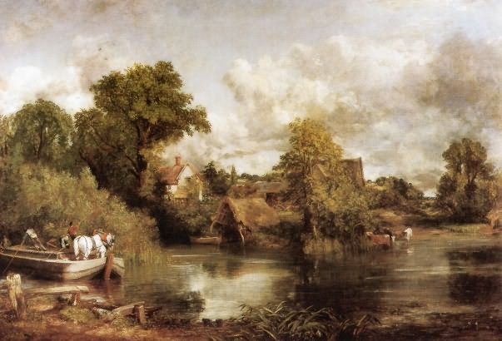
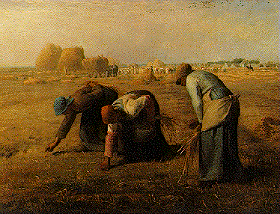
Let’s Compare - Paintings
White Horse - Constable
The Gleaners, 1857 Jean-François Millet
Romantic
Realistic

Slide 11
Your turn!
Now you tell me – which of these is realistic or romantic?

Slide 12
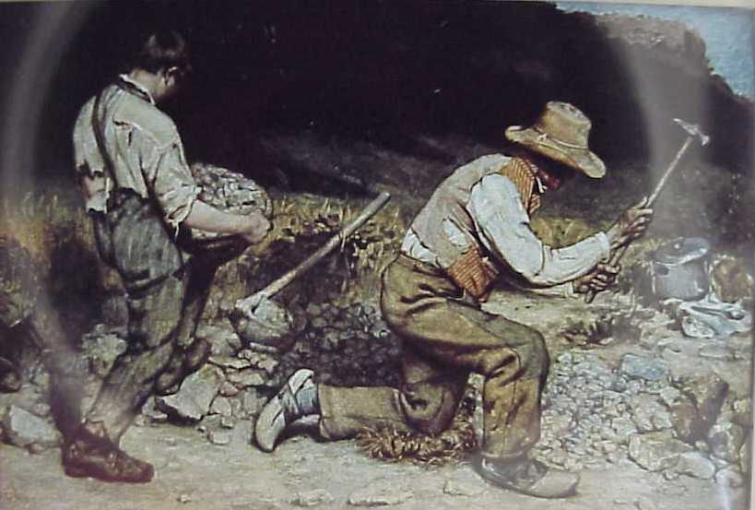
Courbet The Stonebreakers
REALISTIC
Men are ordinary
Ordinary events

Slide 13
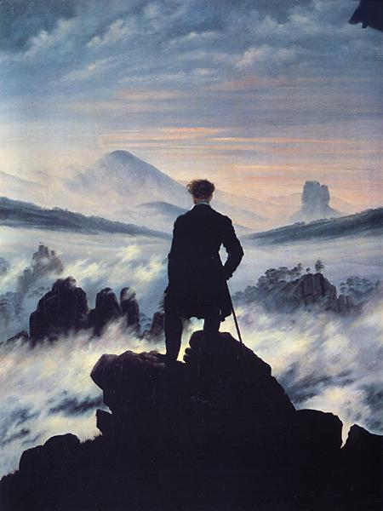
Friedrich – Wanderer
ROMANTIC
Man as “god”
Mysterious
Nature!

Slide 14
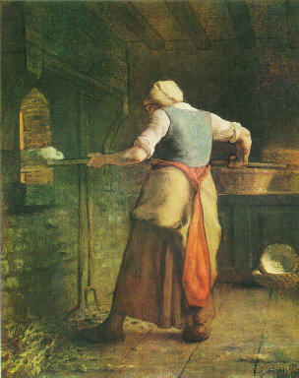
Millet – Woman Baking Bread
REALISTIC!

Slide 15
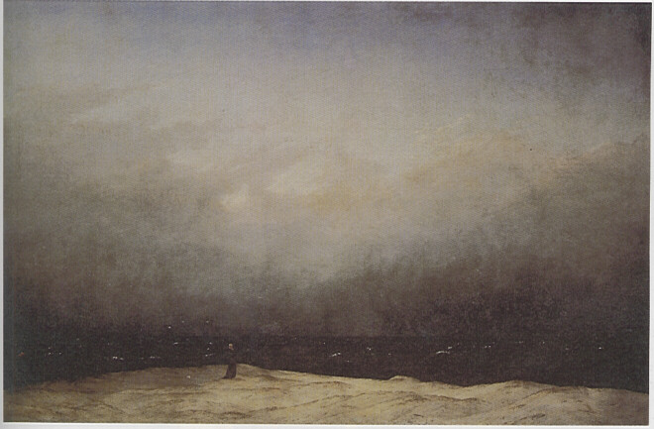
Friedrich - Monk by the Sea
ROMANTIC!
(look at that nature…)

Slide 16
Good Morning! 1/6/2015
Turn-in: Nothing
Take out: Textbook, writing utensil, rom to real packet
Fast Five: None
Homework: book review (if not already finished)
For you ahead of the game: Bacon will review and score your entry then click publish. You may then copy and paste your entry into turnitin.com. I will not enter your score into skyward until turnitin.com is complete. Thanks!

Slide 17
Literature Comparison
Pg 917 line 1 – 20
What is being described?
How is it being described?
Pg 977 first paragraph
What is being described?
How is it being described?
THINK: Characteristics and details which support Romanticism or Realism

Slide 18
Thesis Statement
1. Take apart your prompt
What is my prompt really asking me?
Underline “Using the two pieces you read for the activity”
2. Formulate an opinion (a.k.a. answer the prompt)
3. What will you need to support your opinion?
Text based evidence that I can connect to my opinion – in this case also “people in today’s society”
4. What do you want the reader to gain?(so what)
5. Fill in your how/why, argument, and so what
6. Draft a thesis by combining them.
7. Read it out loud. At least three times.
8. Make edits as necessary
9. Rewrite the final in the “Thesis Statement” section

Slide 19
Good Morning! 1/7/2015
Turn-in: Nothing
Take out: Packet, writing utensil
Fast Five: If you were to put the differences between Romantic and Realist literature in your own words, what would it be?
Homework: None

Slide 20
Respond
In English journal respond:
Pick two characteristics from each Romanticism and Realism
What would each characteristic look like in poetry?
What poetic devices could you use to aid in writing each style of poem?

Slide 21
Subject: Mango
Romantic Lines:
The mighty, magnificent mango sits upon the majestic oak,
An oak, whose life was taken too soon.
The tragedy saddens my soul,
O! How I long to hold the delicate, succulent fruit,
I may understand it’s true wondrous nature,
I may taste the exotic delicacies of it’s orange flesh.
The mango speaks it’s truths as the juice runs languorously Down my hand.
Characteristics: Connection to nature, passionate emotions, formal language.
Lit devices: Alliteration, repetition, enjambment, personification

Slide 22
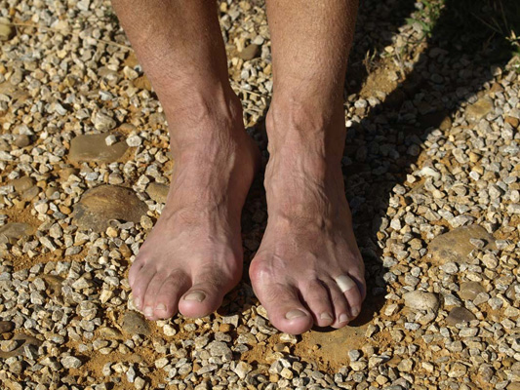
Realistic Lines:
The pale mango sits on a tree stump, taking in the light of the day,
I wonder where you came from little mango?
The pale pink color blended with tan smooth skin of the tree,
Beside the mango was a man wearing no shoes,
The skin of the feet opposed that of the mango and the tree,
Callouses, wrinkles, dirt, stories.
He picked up the mango gingerly in his time worn hands,
Thinking of times long ago.
Characteristics: Ordinary events, setting is for character, ordinary characters.
Lit devices: alliteration, imagery, word choice

Slide 23
Time to create!
Your task is to create two poems. You will select a random object to make the subject of your poem.
POEM 1 – ROMANTIC POEM 2 – REALISTIC
Focus on two characteristics of each and use at least one lit device per poem.
Two Options for Writing:
1. Begin with a Romantic poem. Then rewrite the poem as a scaled back, “simpler version” with focus on specific characteristics of Realism. 2. Begin with a Realistic poem, then rewrite adding exaggerated details with focus on specific characteristics of Romanticism.
IT IS ALL IN THE DETAILS!

Slide 24
Good Morning! 1/9/2015
Turn-in: Romanticism to Realism Packet, Book Vocab Sheet
Take out: Writing utensil, grab bubble sheet
Homework: None
Reminders
Turnitin.com – submit book review to BOTH the library and turnitin.com
Review submitted by the end of day today.
Turn in your individual reading books!
Finals are in a week-ish – expect a study guide and study session by next week. If you are worried, go through PowerPoints on my website, write down list of major texts we read and the main ideas.

Slide 25
Reminder – Process of elimination. You can write on the test.
Staple bubble sheet to test.
Finished early?
Take out a piece of paper – reflect, what did you like about the individual book assignment? What could have been better?
Begin going through notes and making a list of text/topics covered in class and the main idea of each.

Slide 26
Good Morning! 1/12/2015
Turn-in: Nothing
Take out: English Journal, Writing Utensil, Textbook
Fast Five: What are the characteristics of Realism?
Homework: None

Slide 27
Focus in Characterization
Ways author’s portray characters:
Physical description
Character’s words and action
Words and actions of other characters
Direct commentary by the narrator

Slide 28
A Piece of String – Guy de Maupassant
Page 945 – Read “Maupassant’s Norman Roots” Why is it significant?
Answer “Focus your Reading”

Slide 29
Two pages of notes (have both out at the same time)
Copy setting cluster (pg945) into notebook
Also make a table for characterization:
Page/Col Characterization
946/2 Narrator – M.H. is frugal
946/2 Physical - He has pain when he bends over
947/1 Action of character – He hides string in his shirt
948/2 Action of other character -

Slide 30
Mish, Matt, Alysse, Jared, Andrei, Alex T, Jayme, and Emily
Come after school today or before school tomorrow to make up the test! 2410C

Slide 31
Page 948/950
948 - Name three details that give a realistic impression of the scenes described on this page.
950 - Suggest: How this part of the story shows characteristics of Realism. Connect directly to the characteristics.

Slide 32
Page 950
Realism portrays the everyday difficulties and appointments of ordinary people.
Suggest: How this part of the story shows characteristics of Realism. Connect directly to the characteristics.

Slide 33
Final Thoughts
Page 952 in Textbook
Individually
Connect to literature
Think Critically
In groups of 5 – fill out the “Literary Analysis Characterization in Realism” activity and Extend Interpretations
Turn in with stamps sheets attached to the back

